Slide 1
Topic Modeling with
Latent Dirichlet Allocation
Minet Mucka Polsinelli
Taylor Bartel

Slide 2

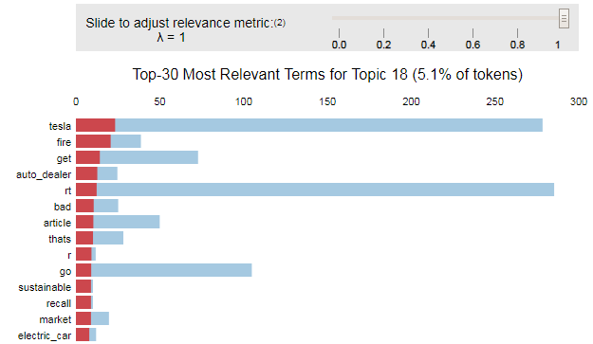



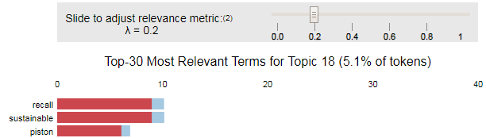


Topic Modeling
Topic modeling is a natural language processing technique that uses hidden connections between words in a collection of documents (e.g. article, survey comment, call agent notes) to classify documents into topics based on semantic relationships
Topic modeling operates on the basic assumption that words that occur together frequently have a similar meaning, i.e. describe the same topic
LDA Generated Topics Elon Musk’s Tweets
Top terms in LDA topic 18
Notes:
In machine learning and natural language processing a “topic” consists of a cluster of words that frequently occur together. And so a topic model is a type of statistical model for discovering the “topics” that occur in a collection of documents. Topic modeling is frequently used as a text-mining tool for the discovery of hidden semantic structures (hidden connections between words) in a text body.
There are many types of collections of documents, such as news articles, however in our group we leverage survey comments (specifically suggestions to improve the service) and call center agent notes describing the call.
The basic assumption is that words that occur together frequently have a similar meaning. In other words are describing the same topic.

Slide 3




Generative versus Discriminative
an important distinction
“Batman opens the present since he's a good guy. It contains a coupon for new parents, but is expired. This is a Joker joke.”
– AI Bot writing Batman Script
There are two types of machine learning in the world …
Generative
This is a bat
This is a batman
Does not require labels (Unsupervised)
Requires user specified topic count
Uses joint probability
Requires more data
Discriminative
Requires Labels (Supervised)
Does not require a defined topic count
Uses conditional probability
Requires less data
Latent Dirichlet Allocation (LDA),
K-Means, Hierarchical Clustering
Logistic Regression, KNN, Random Forest
The benefit of using a generative approach is that you can let your data organize itself, allowing you to discover novel topics
3
Notes:
We can classify machine learning broadly into two categories, discriminative and generative. Most people are familiar with discriminative models. These would be your classic classifiers like decision trees. These uses decision boundaries to classify data, for example a model may be built to differentiate between images of bats and batman.
Another type of machine learning is generative, we can think of generative models as models that try to explain the data by modeling inputs using probability distributions.
For example consider the sentence above, a discriminative model would be able to differentiate this article as … but a generative model learns that batman articles contain certain characters (e.g. batman and joker) and thus are able to generate an example of an article that would be tagged as a “batman”.
The advantage of using a generative approach is that we are able to understand our underlying data in new ways, what this can reveal to us is latent or hidden relationships contained within the data allowing us to come up with new categories.

Slide 4

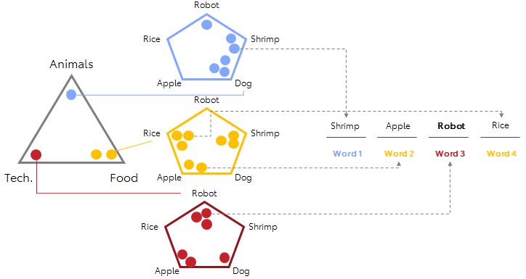
Generative Document Creation
Using probability to discover latent topics and why LDA should stick to topic modeling
Visualization Inspiration: Thushan Ganegedra
https://towardsdatascience.com/light-on-math-machine-learning-intuitive-guide-to-latent-dirichlet-allocation-437c81220158
Notes:
In a moment Minet is going to walk us through how we go from a corpus of documents to meaningful topics, but before I want to take a moment to introduce you to a couple keywords and take a quick look under the hood of LDA.
Lets start with corpus, a corpus is simply a collection of documents you can think of this a website containing articles.
Next a document, a document is simply a collection of words an example of this would be a single article. We see a document as cohesive work but LDA sees a document as mixture of topics, for example a document might be 2 parts food, 1 part technology, and 1 part animals. This is the power of probabilistic distributions, other methods of topic modeling only support a single topic for each document but using LDA we are able to support multiple topics.
Next topics, an example of topic would be different parts of an article. To LDA a topic is seen a distribution of a fixed set of words. If I asked everyone here to write an article that was ½ about food and ½ about animals we would probably see a diverse amount of animals and food terms used. LDA is not as creative, it sticks to the keywords that it was exposed to during training and uses these keywords to generate topics.
And finally words, words need no explanation but the real magic of words in LDA is that every single keyword is meaningful. What I mean by that is, every single keyword has a probability of belonging to each individual topic.
So simply put, LDA is not going to be putting creative writers out of work anytime soon. Despite a lack of creativity, LDA is able to generate documents. To do this LDA draws upon a sampled dataset with a defined number of topics, in this example our documents have 3 topics. Next the generative model selects words to fill up the document until the specified length of the document is reached. Each time the algorithm goes to fill a word it is using the document-topic distribution to select a topic and then the topic-word distribution to select a word.
At the end we have a document that does not mean anything to us but is representative of the sampled document with 50% food related words, 25% tech related words, and 25% animal related words.
So why is this important? This is important because if we assume that documents are generated this way then we can reverse engineer the process and use the topic-word distributions to calculate a probability that a word belongs to each topic.
Let’s take robot for example.
If you had a document that was a single word, robot, this document would be classified as 50% about technology and 17% about animals. We can use this same process to calculate the topic mixture of a document with multiple keywords allowing us to identify similar or prominent topics for each document.
So now I will turn it over to Minet who will discuss how to actually use LDA.

Slide 5
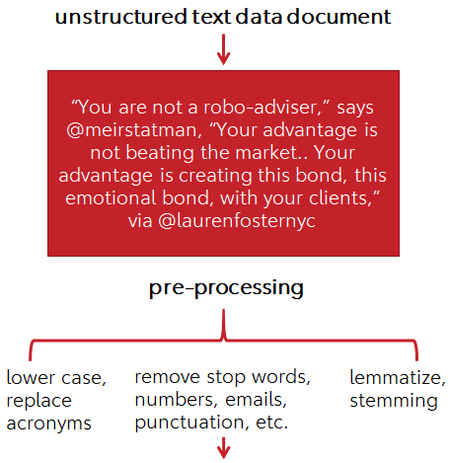
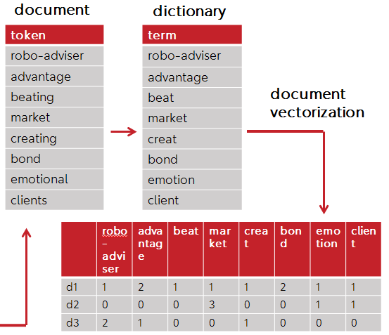

Data Preparation and Cleansing Steps
Notes:
Here we have an example of a document that has unstructured text (non-tabular data with no predefined schema).
So we have to start parsing the document for keywords or tokens (a specific word in the document), and now we are ready to start pre-processing. We need to convert everything to lower case, and replace acronyms.
Now do we want to count every word? Some words don’t add much meaning as they are commonly used. So lets remove what we call stop words, such as “the”, “a”, “an”, “in”. Essentially, prepositions (on, after), determiners (a, the, every), conjunctions (and, but, if).
We also remove numbers, emails, punctuation marks, etc. Then we lemmatize, which means to reduce words to base form. E.g. studies -> study. In other words it aims to remove inflectional endings of words and return the base of a word, known as lemma.
And finally stemming is a much more drastic version of lemmatizing, where algorithms cut off suffixes that can be found in inflected words. E.g. studies -> studi (remove –es).
Once our text is clean we can build the dictionary, where each document (row) is comprised of a set of terms (not tokens anymore). Your final product (corpus) will be a document vectorization, where for each document (row) you will have a set of terms (columns).

Slide 6
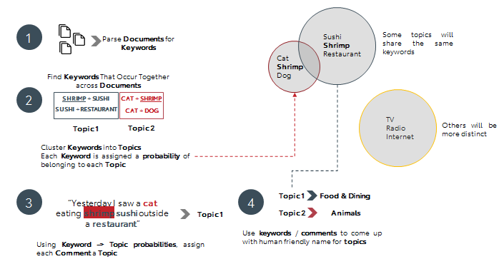
How to create topics from documents
Underlying Assumptions
Every document is made up of a mixture of topics
Every topic is made up of a distribution of keywords
Every keyword has a probability of belonging to a topic
Given a document, we can classify the most likely topic by looking at the document keywords
Notes:
What LDA does is it analyzes documents by creating a bag of words. So words that have a high probability of occurring together are grouped together are represented as topics.
So, the following document reads “Yesterday I saw a cat eating shrimp sushi outside a restaurant”, sushi and restaurant will be assigned to topic 1 “Food & Dining”, where as cat and shrimp will be assigned to topic 2 “Animals.
Also, the size of the topic will be dependent on the number of terms found in the documents. So in this case, topic 1 was had a higher “food & dining” term frequency than topic 2 “animals”.

Slide 7

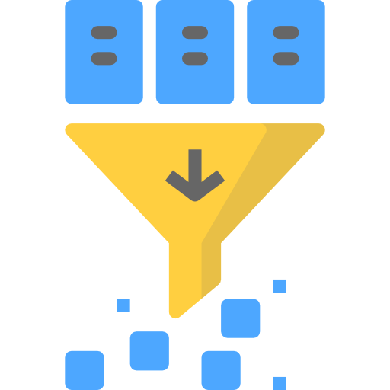

Applications
Topic Classification
Collaborative Filtering (NY times)
Or… to see what Elon Musk has been tweeting about

Slide 8
Appendix

Slide 9
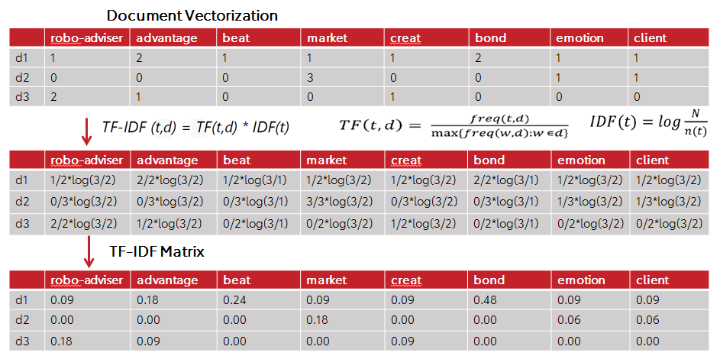
Going from Document Vectorization to TF-IDF Matrix
Notes:
The TF-IDF Matrix is not needed for LDA, however is needed for other text clustering algorithms such as k-means.

Slide 10
Thank you!
minetmucka@gmail.com
taylorabartel@gmail.com

